Slide 1
Automation Framework
Overview

Slide 2
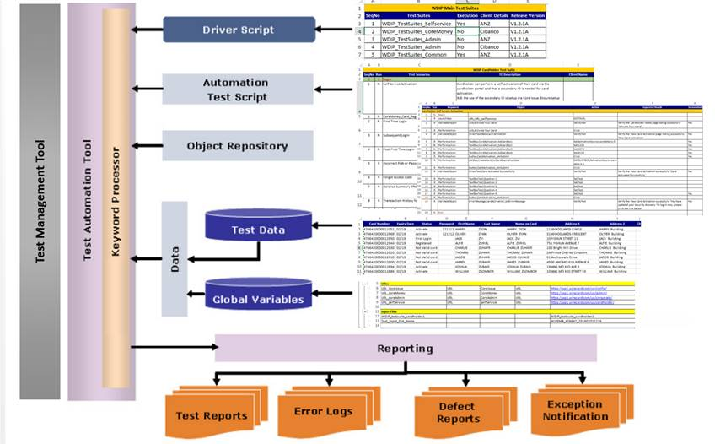
Automation Framework

Slide 3


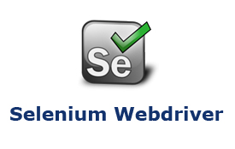
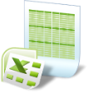


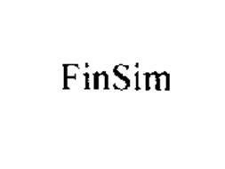








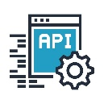
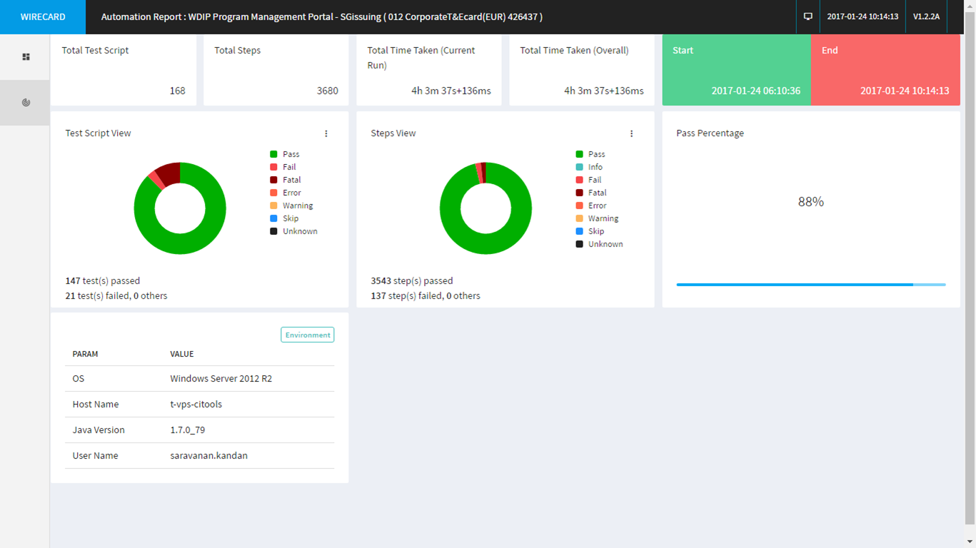
Automation Tools
Continuous Integration
powered by Jenkins - Maven
Excel Based Automation
Test Scripts
Automation Framework
Web Portals
powered by SELENIUM
Scheme Transactions
powered by FINSim
Mobile Apps
powered by APPIUM
Test Automation Report
API
powered by REST ASSURED

Slide 4







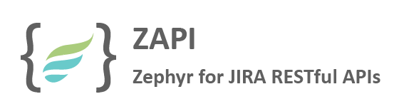
Excel Based Scripting
Jump-host Server
Source Code Repository (SVN)
Continuous Integration Server
3
4
Automation Framework
Extract
Check-in
QA Project
UAT Project
QA Automation Suite
UAT Automation Suite
Web Portals
Web Portals
Core Issue
Core Money
Core Money
6
Core Admin
Core Admin
Update Test Result Repository
Self Service
Self Service
Test Management Tool
CMS
CMS
5
2
Test Status Update
Simulator Transactions
Simulator Transactions
Step 1
1
Manual
Automation
Create Test Case in JIRA

Slide 5
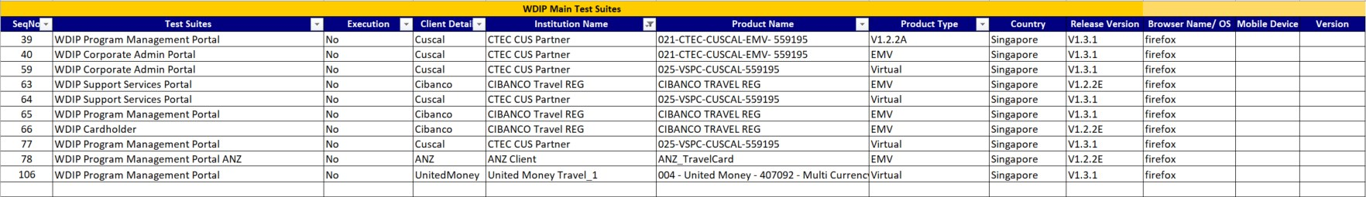
WDIP Main Test Suite
Create Test Case in JIRA

Slide 6
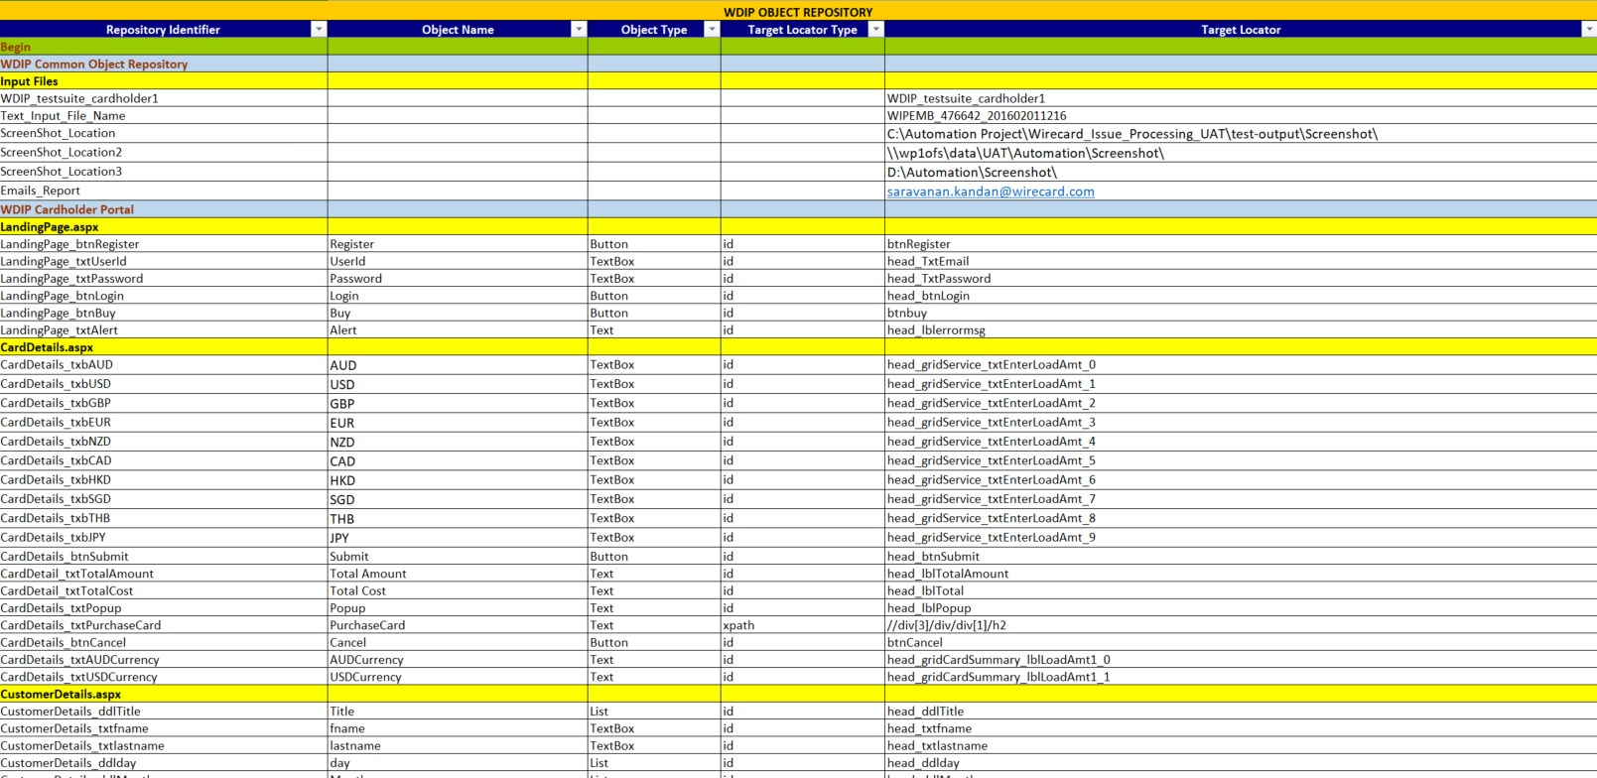
Object Repository
Create Test Case in JIRA

Slide 7
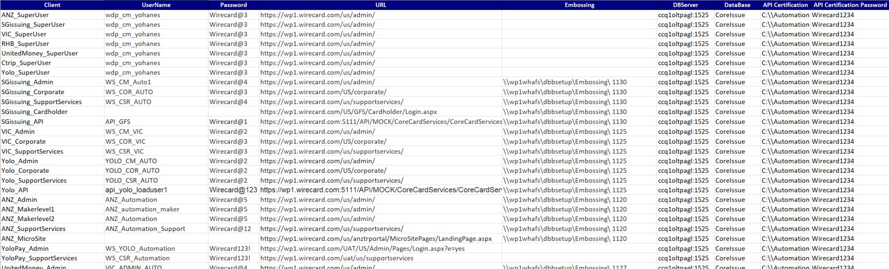
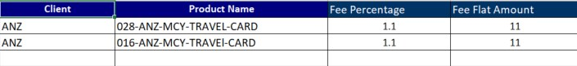
Test Data and Input data
Create Test Case in JIRA

Slide 8
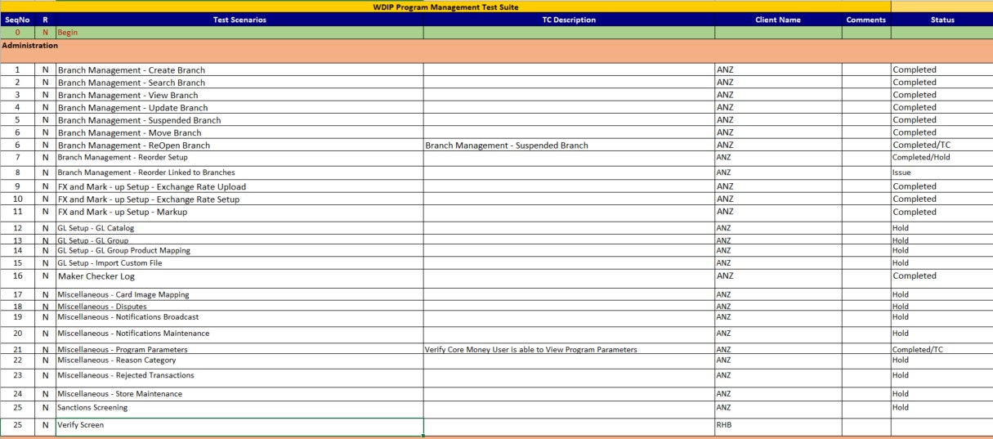
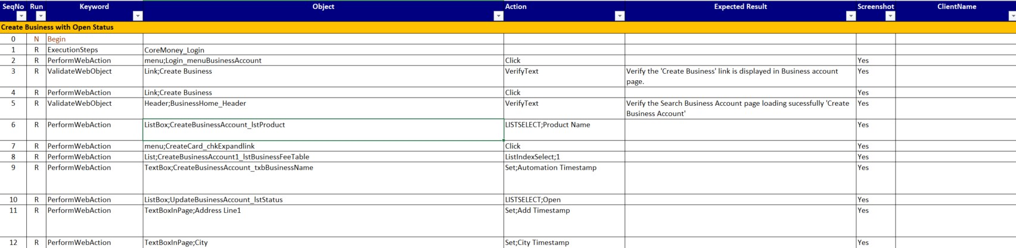
Test Scenarios and Test Scripts
Create Test Case in JIRA

Slide 9
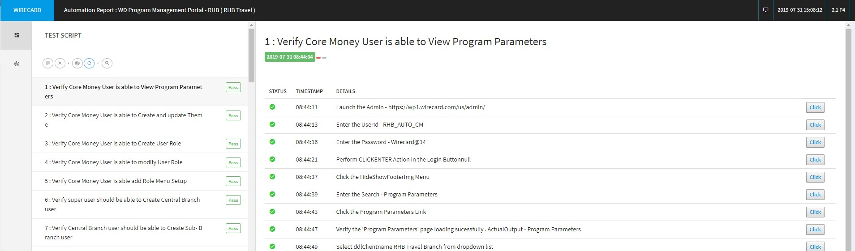
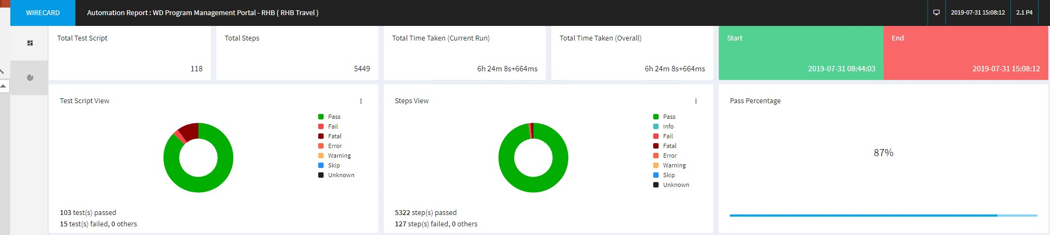
Reports
Create Test Case in JIRA

Slide 10
Thank You

